Slide 1


Slide 2
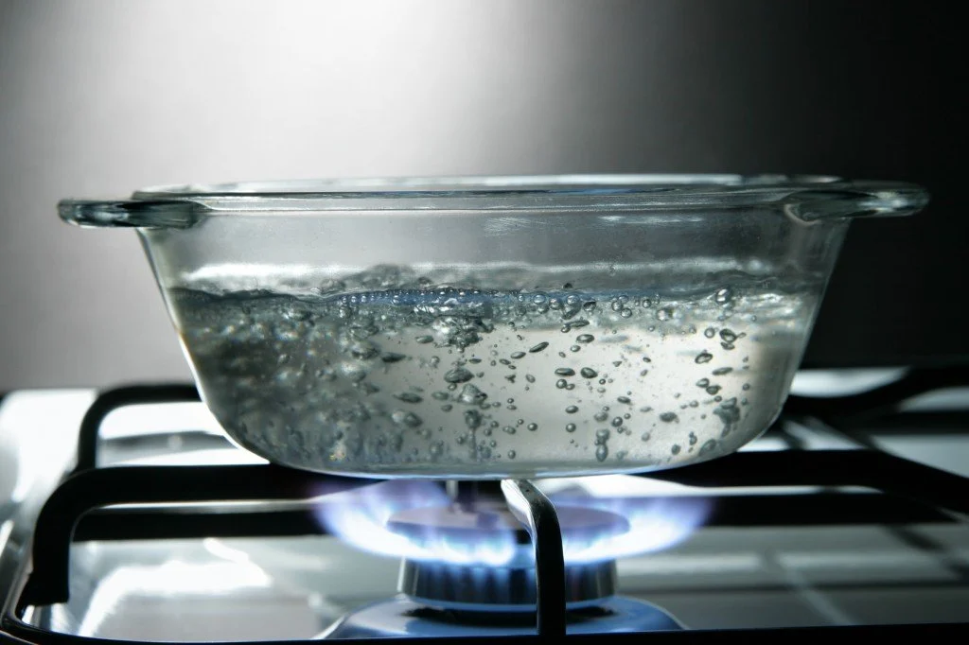
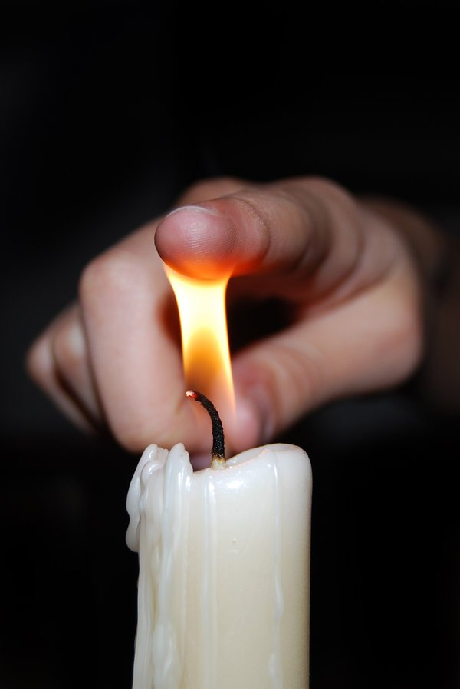
What happens if you heat water to 100 degrees?
It boils.
What happens if you touch fire?
If you touch fire, you get burnt.

Slide 3
If people eat too much, they….
If you touch fire, you…
People die if they don’t…
If babies are hungry, they ...
Zero conditional
Present simple+present simple

Slide 4
Conditionals
The Zero Conditional: (if + present simple, ... present simple) - we refer to facts, science If you heat water to 100 degrees, it boils.

Slide 5
Complete the zero conditional sentences with the correct form of the verbs in brackets.
says
When I meet my best friend, she always _____ (say), ‘What’s new?’
If I get home too late, my parents _____ (be) usually angry.
My mum ______ (make) me a cake when it’s my birthday.
It annoys me if anyone _____ (go) into my room without asking.
If I want to relax, I ______ (listen) to music.
When my parents _______ (have) a busy day, I help make dinner.
are
makes
goes
listen
have

Slide 6
If it rains, I won’t….
If I study tonight, I’ll...
If I have enough money, I’ll buy...
She will be late if ...
First conditional
Present simple + will/won’t

Slide 7
Conditionals
The First Conditional:
(if + present simple, ... will/won’t + infinitive) - we refer to real situations that are likely or unlikely to happen in the future.
If it rains tomorrow, we won’t go to the cinema.
If it doesn’t rain tomorrow, we'll go to the cinema.
We will go to the cinema if it doesn’t rain tomorrow.

Slide 8
1) If we (go) on holiday this summer, we (go) to Spain.
2) If the weather (not/improve) , we (not/have) a picnic.
3) If I (not/go) to bed early, I (be) tired tomorrow.
4) If we (eat) all this cake, we (feel) sick.
If we go on holiday…., we will go to Spain.
If the weather doesn’t improve, we won’t have a picnic.
If I don’t go to bed early, I’ll be tired tomorrow.
If we eat all this cake, we will feel sick.

Slide 9
Choose the correct words to complete the sentences.
1 If you practised more often, you be / would be a really good tennis player.
2 If my team win / won this match, they will be in the finals.
3 If you enter the competition, you will easily win / would easily win a prize.
4 If you kick the ball in the net, you would score / score a goal.
5 If the school has / had a track, we would run a lot more.

Slide 10
Rewrite the sentences in the passive.
They filmed the documentary in the Amazon rainforest.
……………………………………………………….
They saw the dolphins in the sea in South Africa.
……………………………………………………….
You can locate the world’s biggest desert in northern Africa.
People find lots of plastic bottles on beaches.
You can transport most things on ships.
The documentary was filmed in the Amazon rainforest.
The dolphins were seen in the sea in South Africa.

Slide 11
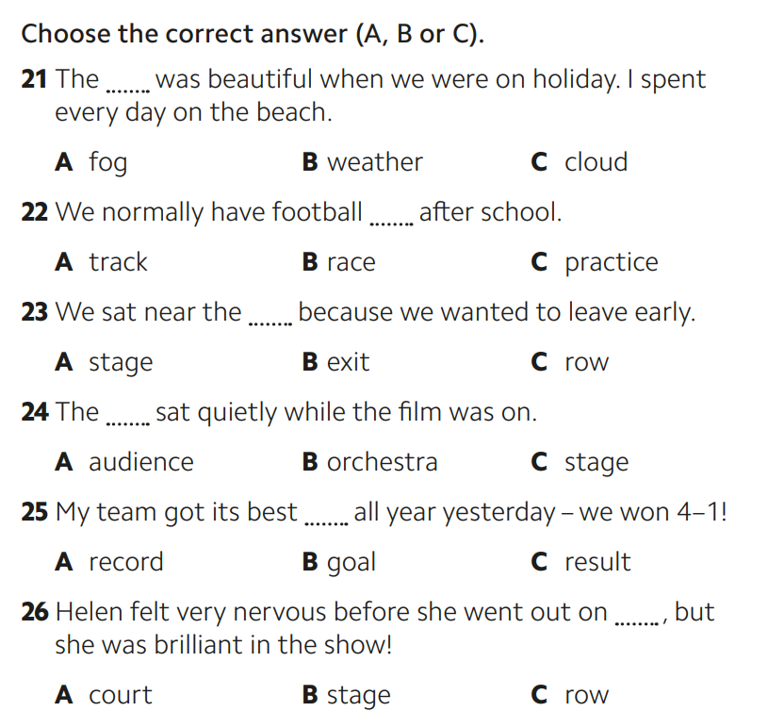

Slide 12
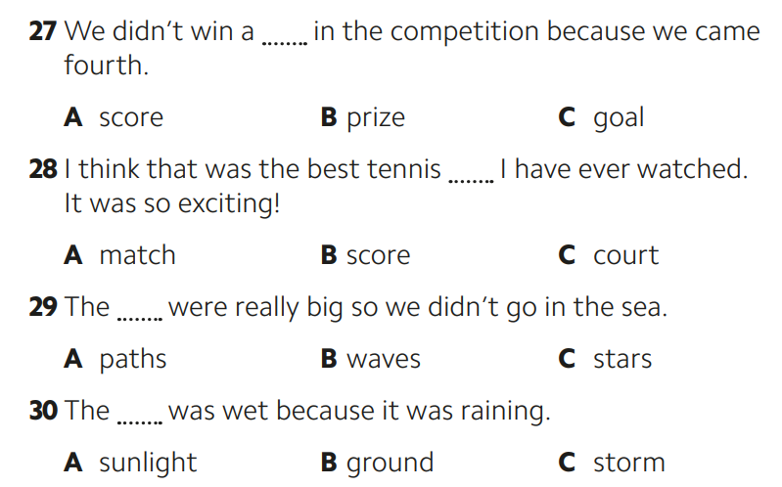

Slide 13
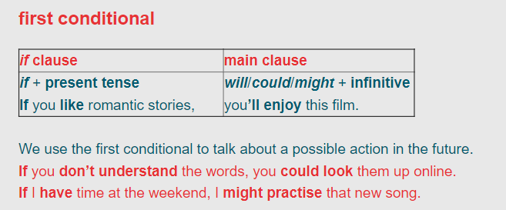

Slide 14
If you get back late, ...
If the weather doesn’t improve, ...
If you don’t want to go out, ...
They will go to the party if...
First conditional
Present simple + will/won’t

Slide 15
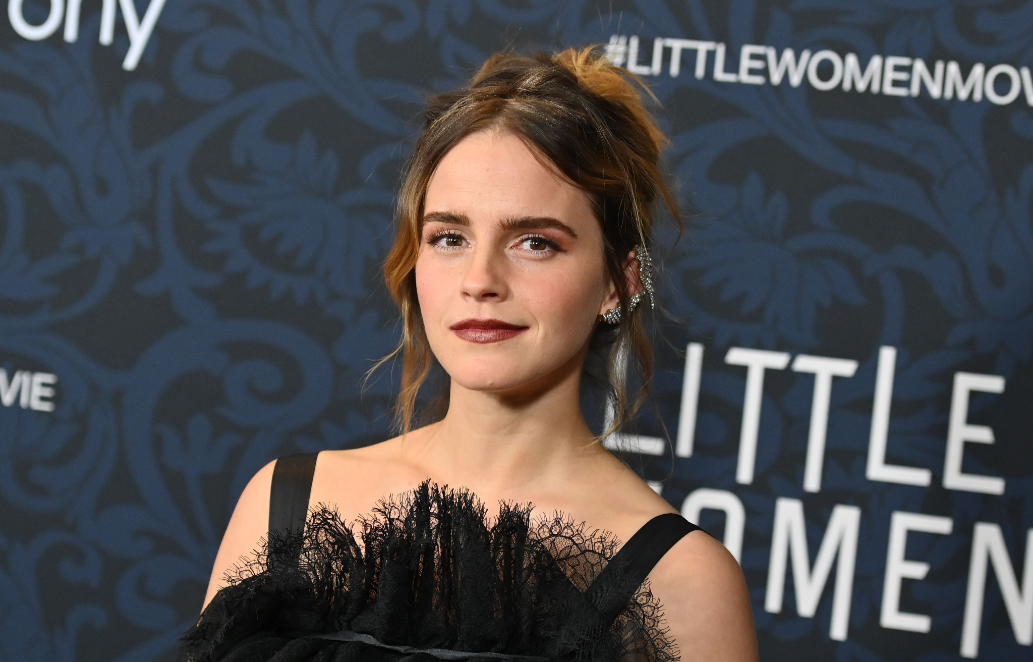
What would you ask Emma Watson if you met her?
If I met Emma Watson, I would ask her….

Slide 16
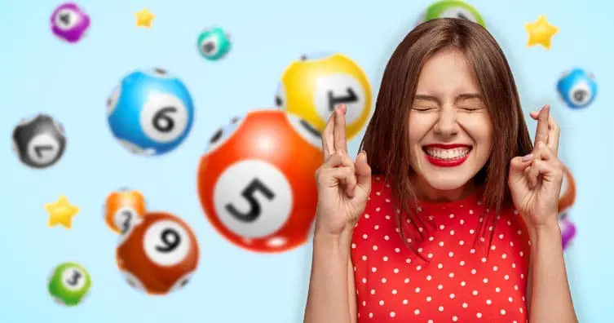
What would you do if you won eur 10, 000?
If I won eur 10,000, I would…

Slide 17
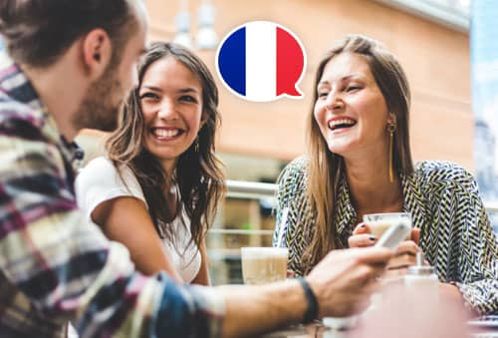
What would you do if you spoke perfect French?
If I spoke perfect French, I would…

Slide 18
The Second Conditional:
(if + past simple, ... would + infinitive) - unreal situations
If I had a lot of money, I would travel around the world.
If I spoke perfect English, I would …..
(if I were you, I would + infinitive) - giving advice

Slide 19
2nd Conditional:
past simple + would/wouldn’t
1) If I (be) you, I (get) a new job.
2) If he (be) younger, he (travel) more.
3) If we (not/be) friends, I (be) angry with you.
4) If I (have) enough money, I (buy) a big house.
5) If she (not/be) always so late, she (be) promoted.
If I were you, I would get a new job.
If he was younger, he would travel more.
If we weren’t friends, I would be angry with you.
If I had enough money, I would buy a big house.
If I wasn’t always late, she would be promoted.

Slide 20
6) If we (win) the lottery, we (travel) the world.
7) If you (have) a better job, we (be) able to buy a new car.
8) If I (speak) perfect English, I (have) a good job.
9) If we (live) in Mexico, I (speak) Spanish.
If we won the lottery, we would travel the world.
If you had a better job, we would be able to buy a new car.
If I spoke perfect English, I would would have a good job.
If we lived in Mexico, I would speak Spanish.

Slide 21
6) If she (win) the lottery, she (travel) the world.
7) If Patrick (have) a better job, we (be) able to buy a new car.
8) If I (speak) perfect English, I (have) a good job.
9) If we (live) in Mexico, I (speak) Spanish.
If she won the lottery, she would travel the world.
If Patrick had a better job, we would be able to buy a new car.
If I spoke perfect English, I would would have a good job.
If we lived in Mexico, I would speak Spanish.

Slide 22
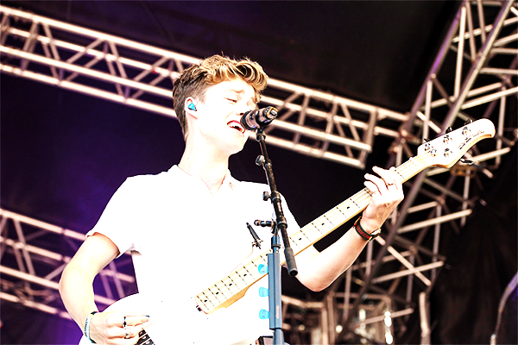
What would you do IF … ?
Every week at Pop News we invite our readers to ask their favourite celebrity the question ‘What would you do if … ?’ This week we say hi to Billy from the band IDX.
Hi, Billy! What would you do if you 1_______ (not be) in a pop group?
Ah, a difficult question! If I 2 __________ (not sing), I’d be really bored. Singing is my passion.
If you won the lottery, what 3 _____ (you/buy)?
Great question! If I 4 _______ (have) lots of money, I’d buy a big house for my family.
Billy, if you had another pet, what 5 ______ (it/be)?
Well, I’ve already got two dogs, but if I 6 ______(get) another pet, it’d be a snake.
We know you hate flying, Billy. So what would you do if the band 7 _____(want) to do a concert in another country?
Well, if it wasn’t too far, I 8 ____________ (travel) by train. I love trains.
weren’t
didn’t sing
would you buy?
had
would it be
got
wanted
would travel

Slide 23
open your book on
p.60 exr. 4

Slide 24
Exam practice on
p. 128 exr.7

Slide 25
If I were you, I would…
Si yo fuera tu, …
Notes:
https://wordwall.net/es/resource/27588471/ge-b1-speaking-if-i-were-you

Slide 26
What would you do if you won the lottery?
If I won the lottery, I would _______
What would you do if you could go anywhere in the world?
If I could go anywhere, _______
What would you do if you were 10 years older?
If I was 10 years older, _______

Slide 27
If I were you, I’d…
I left my phone on the bus
I want to be fitter but I don’t like going to the gym
I need to lose some weight
I want to improve my Spanish
I’m addicted to playing video games
I’m being bullied by some people on social media

Slide 28
Related words
Record a _____/______
Interview _______/________
Perform _______/______/______________
Book a ______/_________
Film _______/__________/________
song
album
an actor
a famous person
on stage
in a play
in a TV show
ticket
a seat
a scene
a documentary
a programme

Slide 29
Listen to five recordings. What is happening in each one? Use verbs below in your answers:
book clap
entertain film
interview perform
record review

Slide 30
The Third Conditional (if + past perfect, ... would + have + past participle) - we refer to the past.
If I had gone to bed early, I would have caught the train.

Slide 31
Inverted Conditionals
Inversions make our sentence sound surprising or striking or unusual. It also sounds quite formal and is mainly used in writing:
I have seldom seen such beautiful work.
Inversion: Seldom have I seen such beautiful work.
('Seldom' is at the beginning, so we use inversion. This sentence emphasizes what beautiful work it is)
normal word order
Subject + verb
Inverted word order
Special adverb + verb + subject

Slide 32
Present simple with any verb except 'be' - 'do' or 'does'):
do you go / does he go
Past simple with any verb except 'be' - 'did':
did we go / did they go

Slide 33
Hardly | Hardly had I got into bed when the telephone rang.
Never | Never had she seen such a beautiful sight before.
Seldom | Seldom do we see such an amazing display of dance.
Rarely | Rarely will you hear such beautiful music.
Only then | Only then did I understand why the tragedy had happened.
Not only ... but | Not only does he love chocolate and sweets but he also smokes.
No sooner | No sooner had we arrived home than the police rang the doorbell.
Scarcely | Scarcely had I got off the bus when it crashed into the back of a car.
Only later | Only later did she really think about the situation.

Slide 34
Nowhere | Nowhere have I ever had such bad service.
Little | Little did he know!
Only in this way | Only in this way could John earn enough money to survive.
In no way | In no way do I agree with what you're saying.
On no account | On no account should you do anything without asking me first.

Slide 35
Inversion in the second part of a sentence
Not until | Not until I saw John with my own eyes did I really believe he was safe.
Not since | Not since Lucy left college had she had such a wonderful time.
Only after | Only after I'd seen her flat did I understand why she wanted to live there.
Only when | Only when we'd all arrived home did I feel calm.
Only by | Only by working extremely hard could we afford to eat.

Slide 36
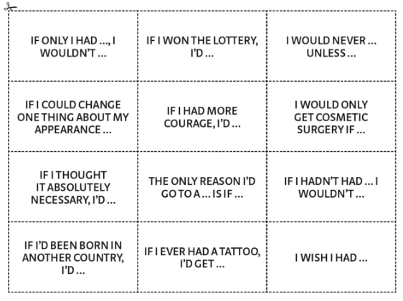
Student A Pick a card, read and complete the sentence.
Student B Express a reaction to what Student A just said and ask a follow-up question.
Student A Answer Student B’s question.

Slide 37
Work in pairs
1. Make a note of 5 regrets you have about the past. Then discuss what would or might have happened if you had/hadn’t done what you did.
Example: I didn’t audition for a dance school. If I had, I might have become a famous dancer.
2. Write down the names of three people who have been important in your life. Then discuss how life would have been different in you hadn’t met them.
Example: If I hadn’t admired my drama teacher so much, I probably wouldn’t have become an actress.

